Slide 1

Deep Dive into Spring Data R2DBC
Exploring reactive relational database connectivity and its transformative approach to data access in modern Java applications

Slide 2
Understanding R2DBC Fundamentals
What is R2DBC?
Core Architecture
R2DBC stands for Reactive Relational Database Connectivity—an open specification bringing reactive programming principles to SQL databases.
The Pipeline: Returns Flux (multiple items) or Mono (single item) instead of blocking Lists
Resource Efficiency: Small, fixed thread pool handles thousands of concurrent connections
Traditional JDBC is blocking. When a query takes 2 seconds, your Java thread sits idle, waiting. R2DBC transforms this with non-blocking, event-driven data access.
Backpressure: Applications control data flow to prevent memory overflow

Slide 3
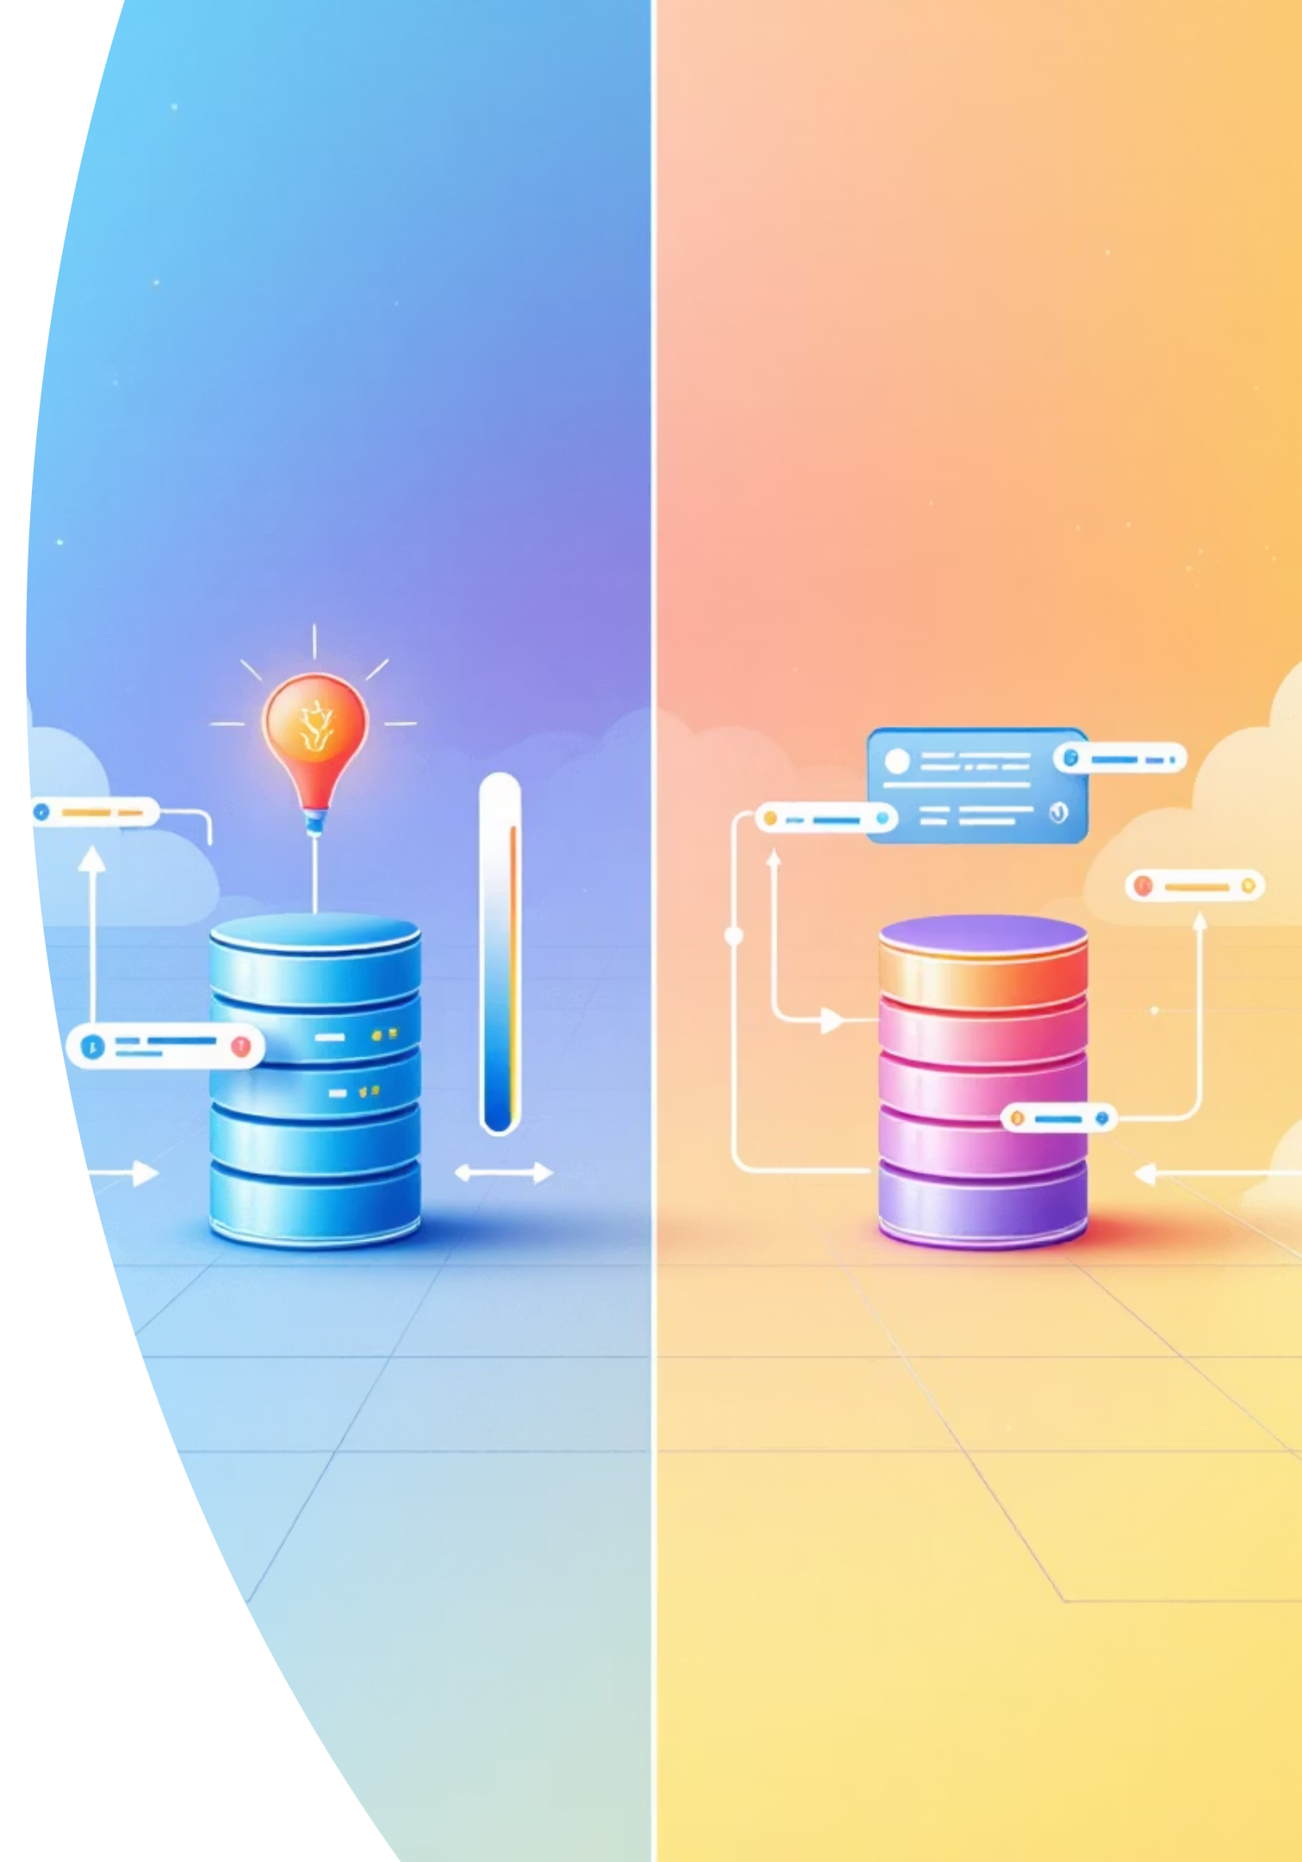

JPA vs R2DBC: A Technical Comparison
Traditional JPA/JDBC
Thread-per-request model
Blocking I/O operations
Rich ORM features and lazy loading
Mature ecosystem with decades of tooling
Spring Data R2DBC
Event loop with fixed threads
Non-blocking reactive streams
Explicit data fetching and mapping
Native WebFlux integration

Slide 4


Weighing the Trade-offs
The Advantages
The Challenges
No Lazy Loading
Manual fetching and mapping of related data required
Exceptional Scalability
Handle massive concurrency with minimal CPU and RAM overhead
Steep Learning Curve
Demands solid understanding of Project Reactor patterns (map, flatMap, zip)
Full Transparency
Ecosystem Maturity
Complete control over SQL execution—no hidden N+1 query issues
Lacks decades of advanced tooling like complex ORM features and auditing
Modern Integration
Seamless end-to-end reactive streams with Spring WebFlux

Slide 5
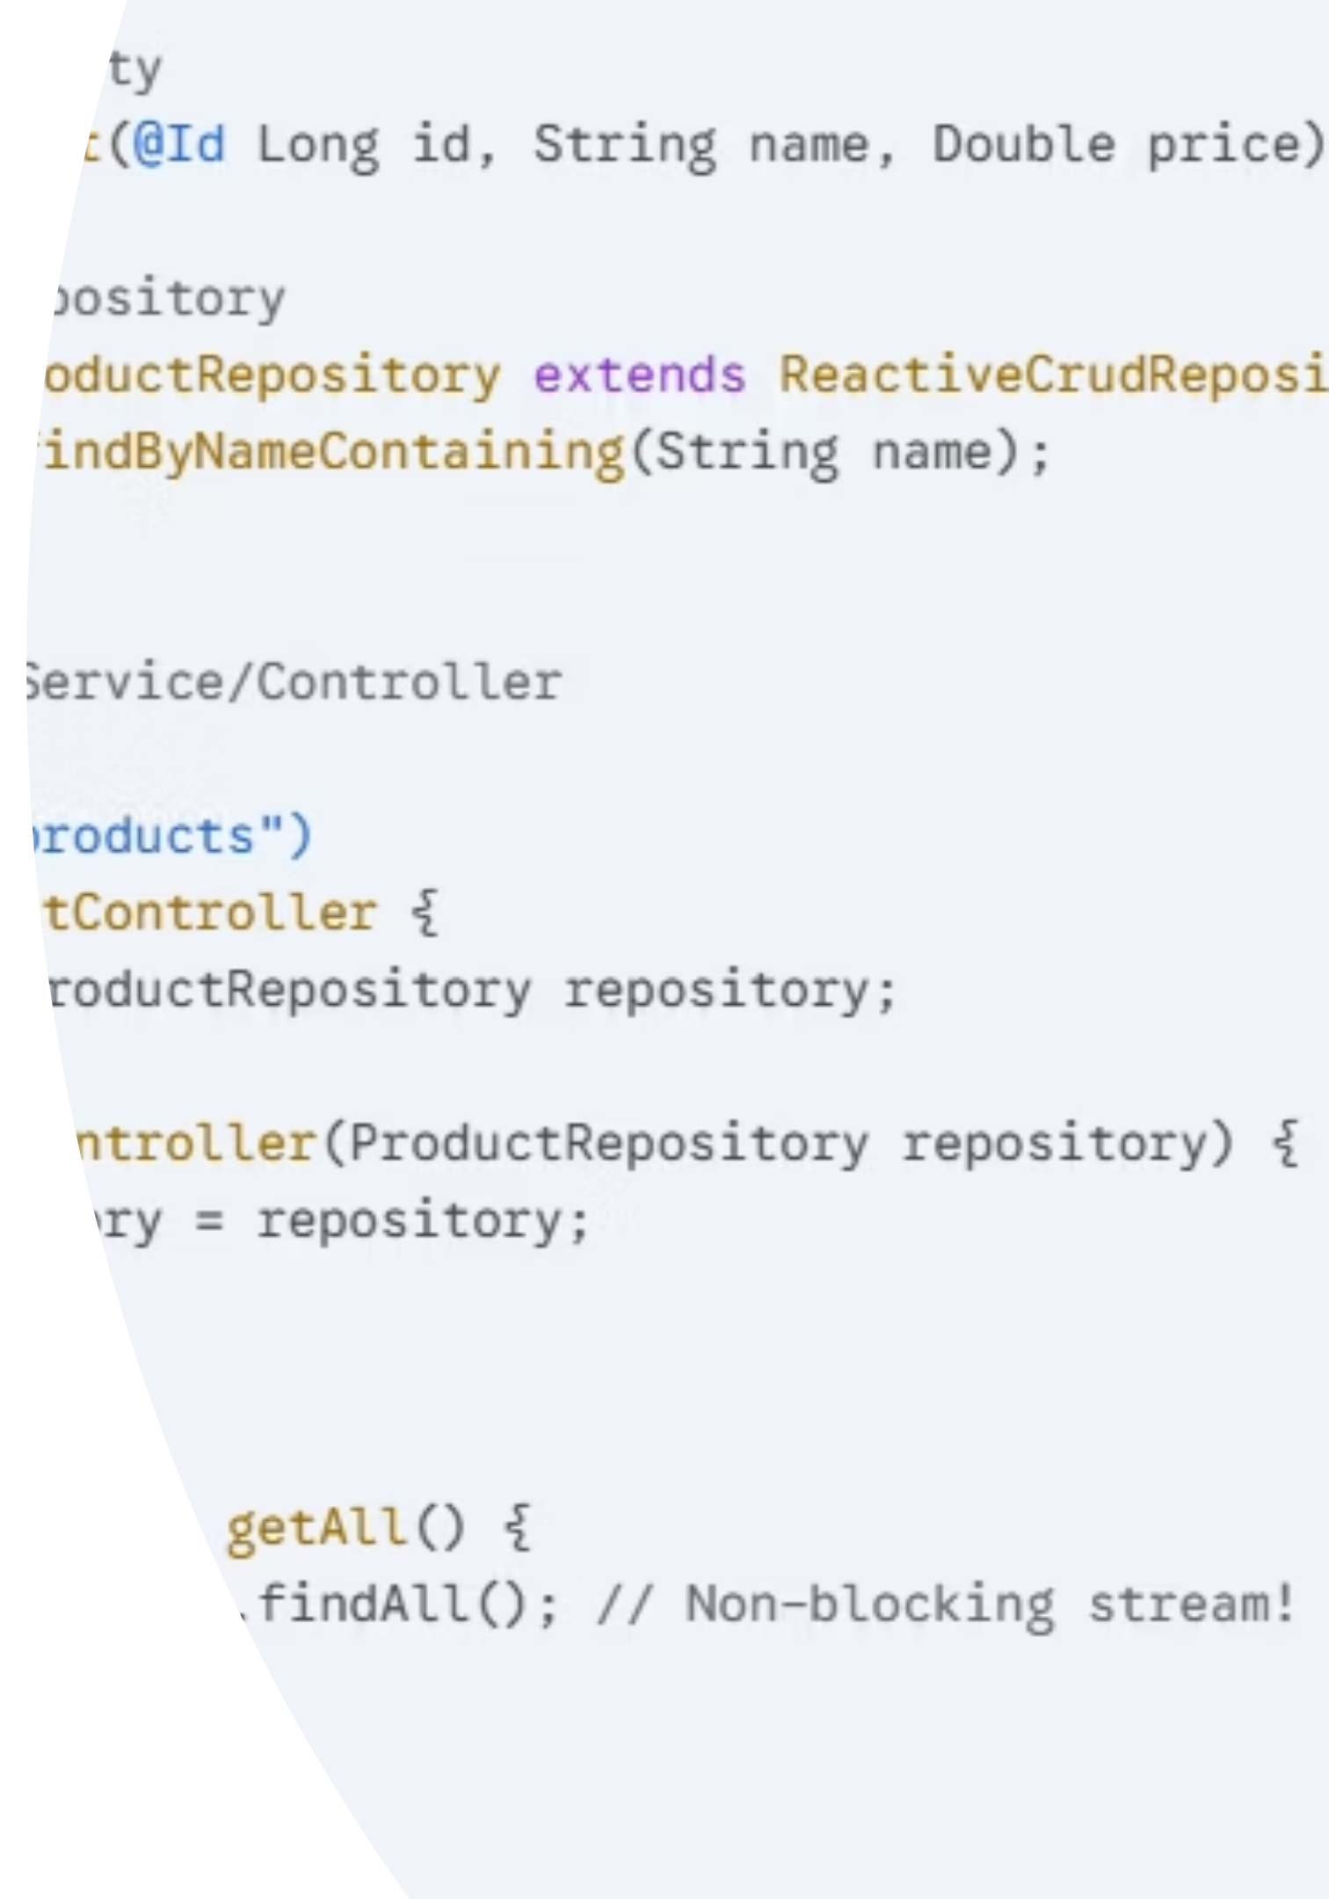
Getting Started: Implementation Essentials
Add spring-boot-starter-data-r2dbc and your database driver (e.g., r2dbc-postgresql) to begin building reactive data access layers.
Configure your database connection in application.properties and create reactive repositories extending ReactiveCrudRepository to leverage reactive query methods.

Slide 6

Making the Right Choice
Choose R2DBC When:
Building high-concurrency systems like streaming APIs or real-time dashboards
Deploying microservices where memory footprint must stay minimal
Working with flat data models without deeply nested relationships
Stick to JPA/JDBC When:
Leveraging complex ORM features like cascades and sophisticated mappings
Team lacks reactive programming expertise (high learning investment)
Handling low-to-medium traffic where traditional thread pools suffice

